Slide 1
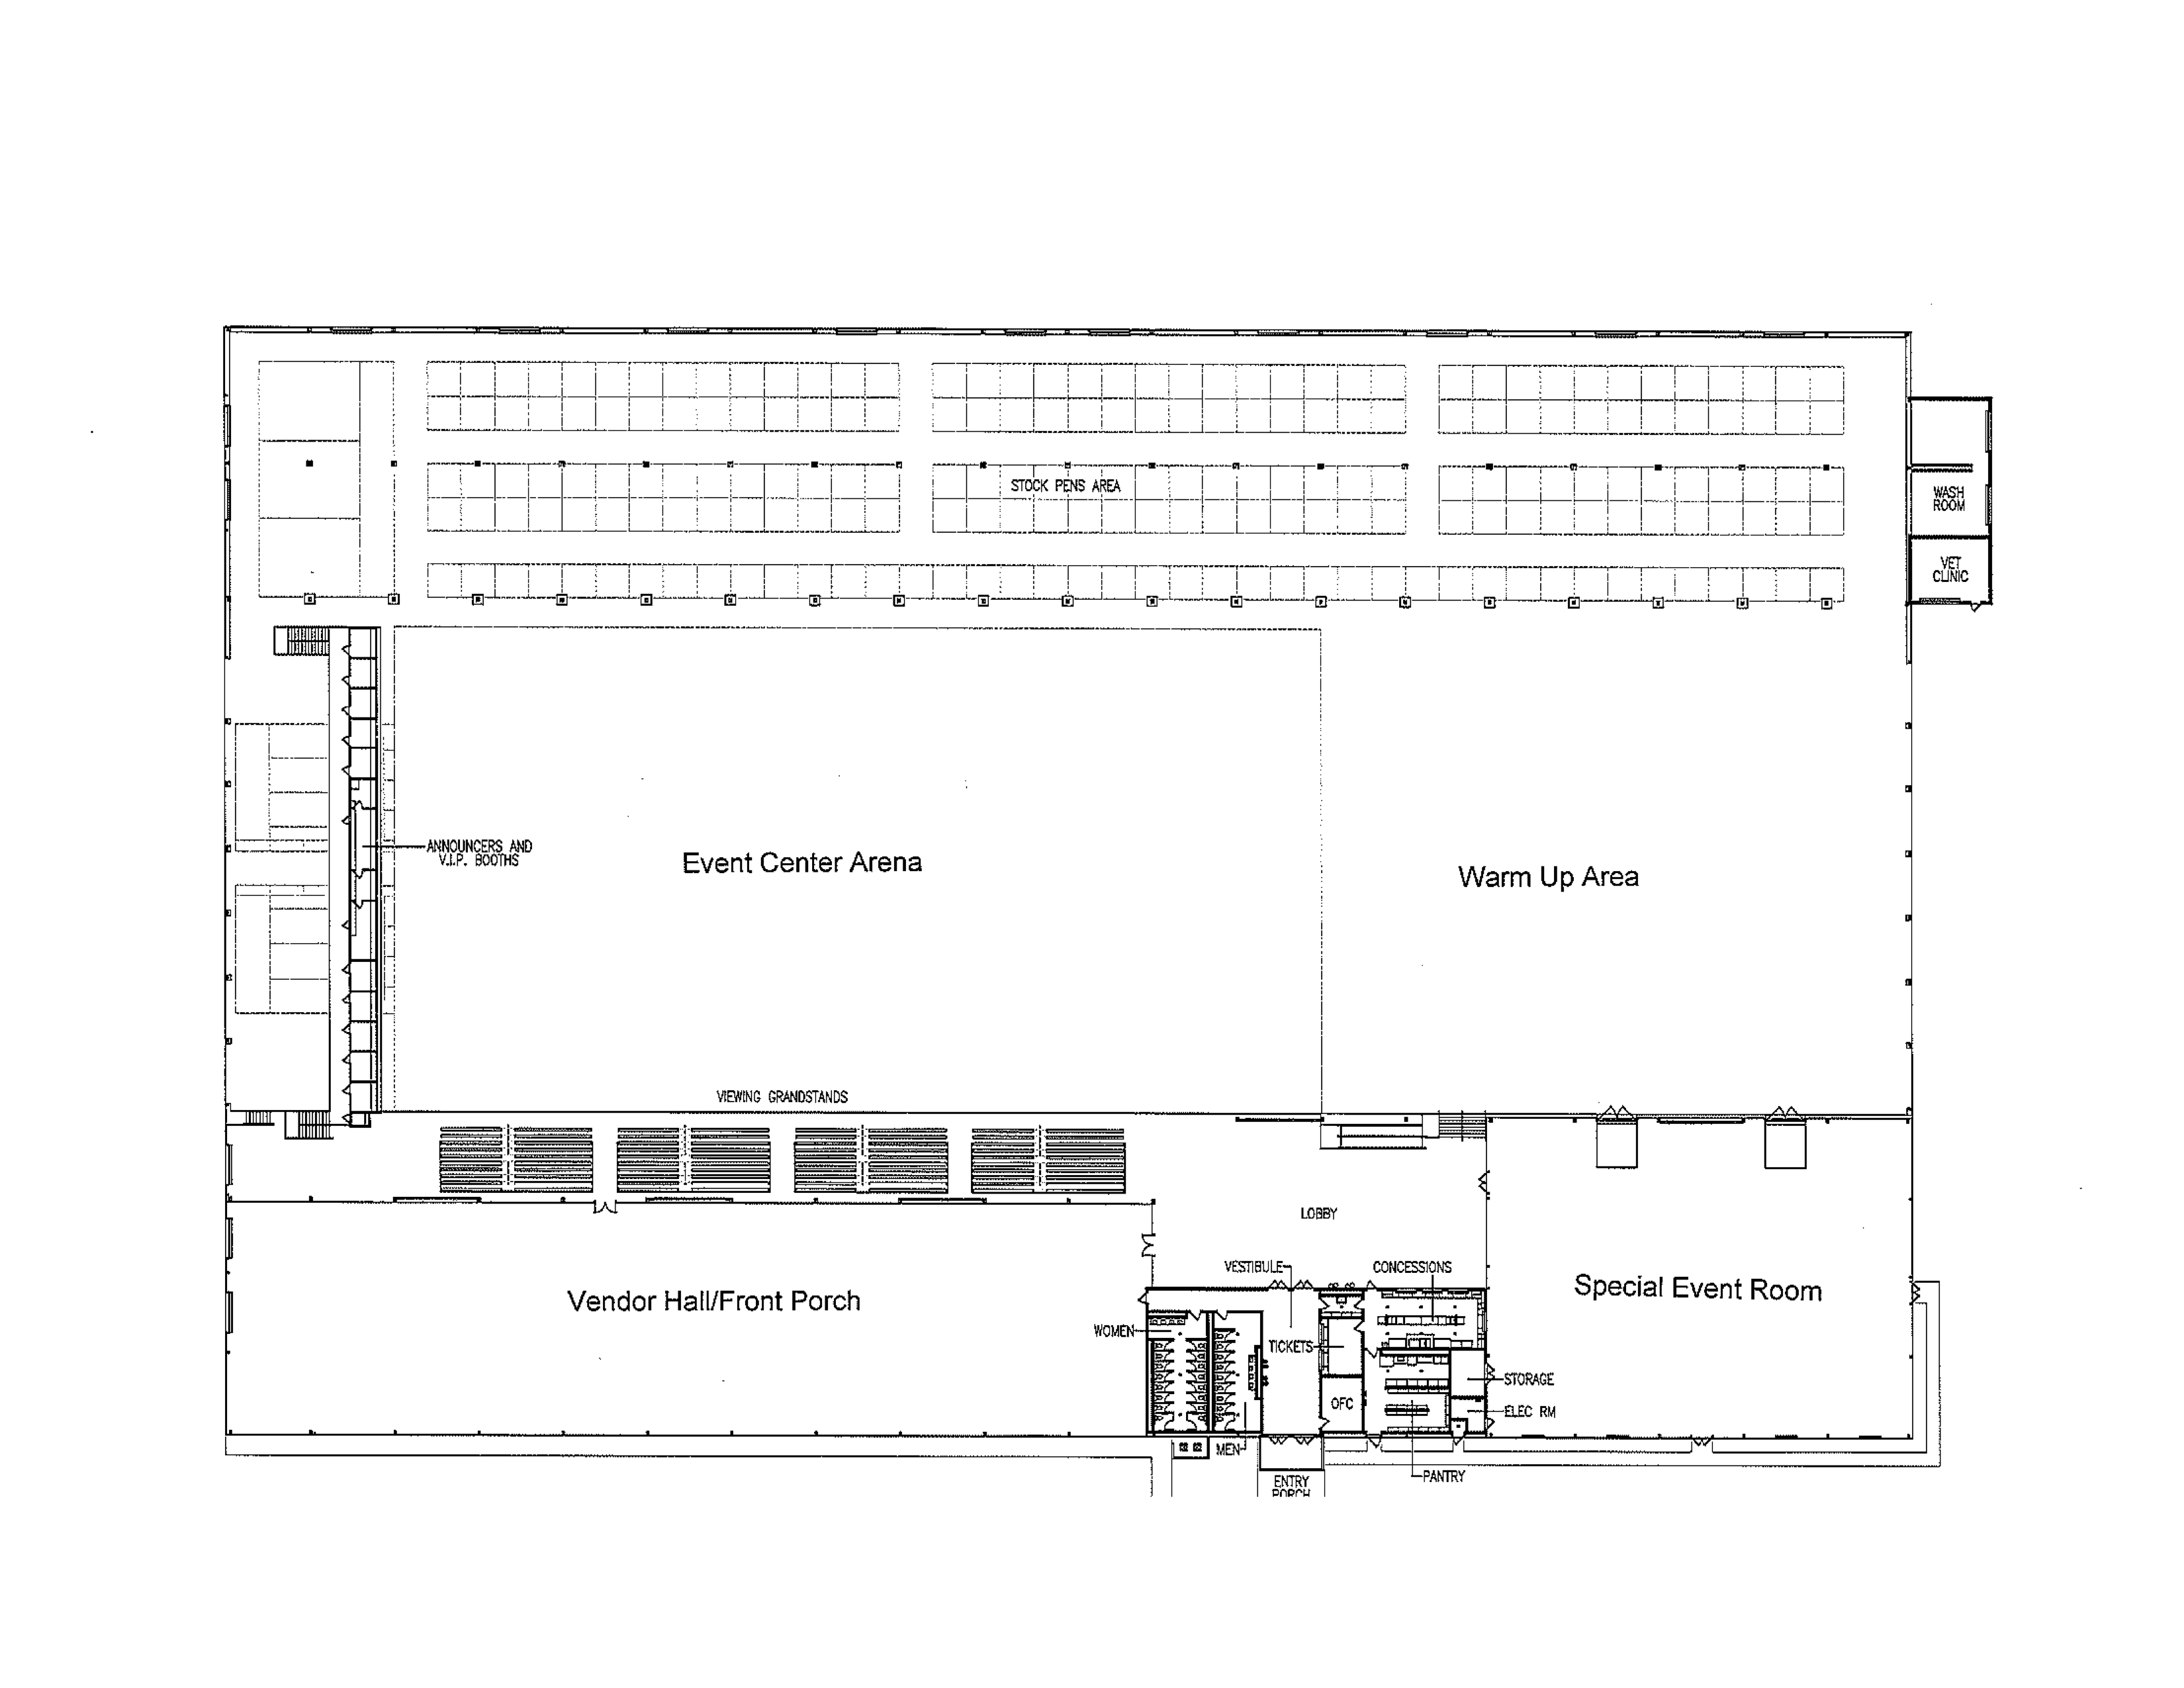
C D E F
G H I
6 7 8 9 10 11 12 13 14 15 16 17 18 19 20 21
A
B
L
M
N
W
X
1
2
3
4
5
J K
38 39 40 41 42 43 44 45 46 47 48 49 50 51
J K
52 53 54 55 56 57 58 59 60 61 62 63 64 65
Y
Z
22 23 24 25 26 27 28 29 30 31 32 33 34 35 36 37
O P Q R
S T U V
10x10 commercial booth – x65
Food Truck
10x10 non-profit booth – x11
10x10 school or non-profit booth – x15
Tables
Updated: April 6th
Stage (approx. 15x15)
Chairs
Indicates a booth no longer available

Slide 2
B C D E
F G H
6 7 8 9 10 11 12 13 14 15 16 17 18 19
A
I
J
M
N
O
X
Y
1
2
3
4
5
L K
34 35 36 37 38 39 40 41 42 43 44 45 46
I
J K
Food
Z
ZZ
47 48 49 50 51 52 53 54 55 56 57 58 59
20 21 22 23 24 25 26 27 28 29 30 31 32 33
II
P Q R S
T U V W
10x10 commercial booth – x59
Food Truck
10x10 non-profit booth – x12
Entrance
10x10 school or non-profit booth – x15
Tables
Updated: July 1st
Stage (approx. 15x15)
Chairs
Indicates a booth no longer available

